Slide 1
PROGRAM FOR CONCRETE MIX DESIGN
GROUP MEMBERS
T.JYOTHIRMAYI
18109014
K.VIJAY BHASKAR REDDY
18109018
CH.MANOJ KUMAR REDDY
18109008
GUIDE NAME
Dr.T.S PARVATI

Slide 2
Introduction
Concrete is most widely used construction material in the world.
It is obtained by mixing cement,fine aggregate, coarse aggregate,water and admixtures in required proportions .
The mixture when placed in form work and allowed to cure becomes hard like stones.
The hardening is caused by chemical action between water and the cement due to which concrete grows stronger with age .

Slide 3
Objectives
To calculate the mix ratio for M 30 grade of concrete as per IS10262:2009 .
To determine the compressive strength of the concrete after 28 days of curing.
To develop a MATLAB program for calculating the mix ratio for different grades of concrete.

Slide 4
Scope
Concrete cubes are cast and tested at the end of 7,14 and 28 days of curing for M 30 grade concrete. Mix design is as per IS 10262:2009.
MATLAB programme gives the mix design values for M20 , M30 , M40 concrete.

Slide 5
Methodology
Determine the physical properties of cement ,sand ,coarse aggregate.
To obtain mix ratio for M 30 grade concrete as per IS10262:2009.
Casting and Testing of cubes.
To develop a MATLAB program for mix design of concrete.

Slide 6
Materials and Methods
Physical Properties
Specific gravity of cement = 2.88
Specific gravity of fine aggregate = 2.65
Specific gravity of coarse aggregate = 2.74
Specific gravity of chemical admixture =1.145 (Master sky Glenium B233)
Chemical composition of Cement
OXIDE | PERCENT CONTENT | OXIDE | PERCENT CONTENT
CaO | 60-67% | Fe2O3 | 0.5-6%
SiO2 | 17-25% | MgO | 0.1-4%
Al2O3 | 5-8% | SO3 | 1-3%

Slide 7
Mix design
Mix Design was carried out as per IS 10262:2009
MATERIALS | REQUIRED AMOUNT
CEMENT | 350 Kg/m3
CHEMICAL ADMIXTURE | 7 Kg/m3
CORSE AGGREGATE | 1262.2 Kg/m3
FINE AGGREGATE | 773.6 Kg/m3
WATER | 140 Kg/m3
Mix ratio for M30 obtained is 1: 2.2 : 3.6

Slide 8
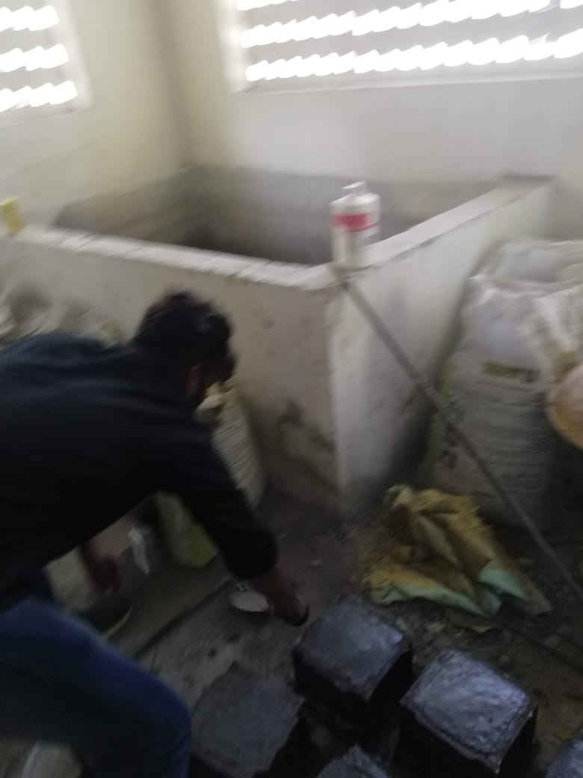
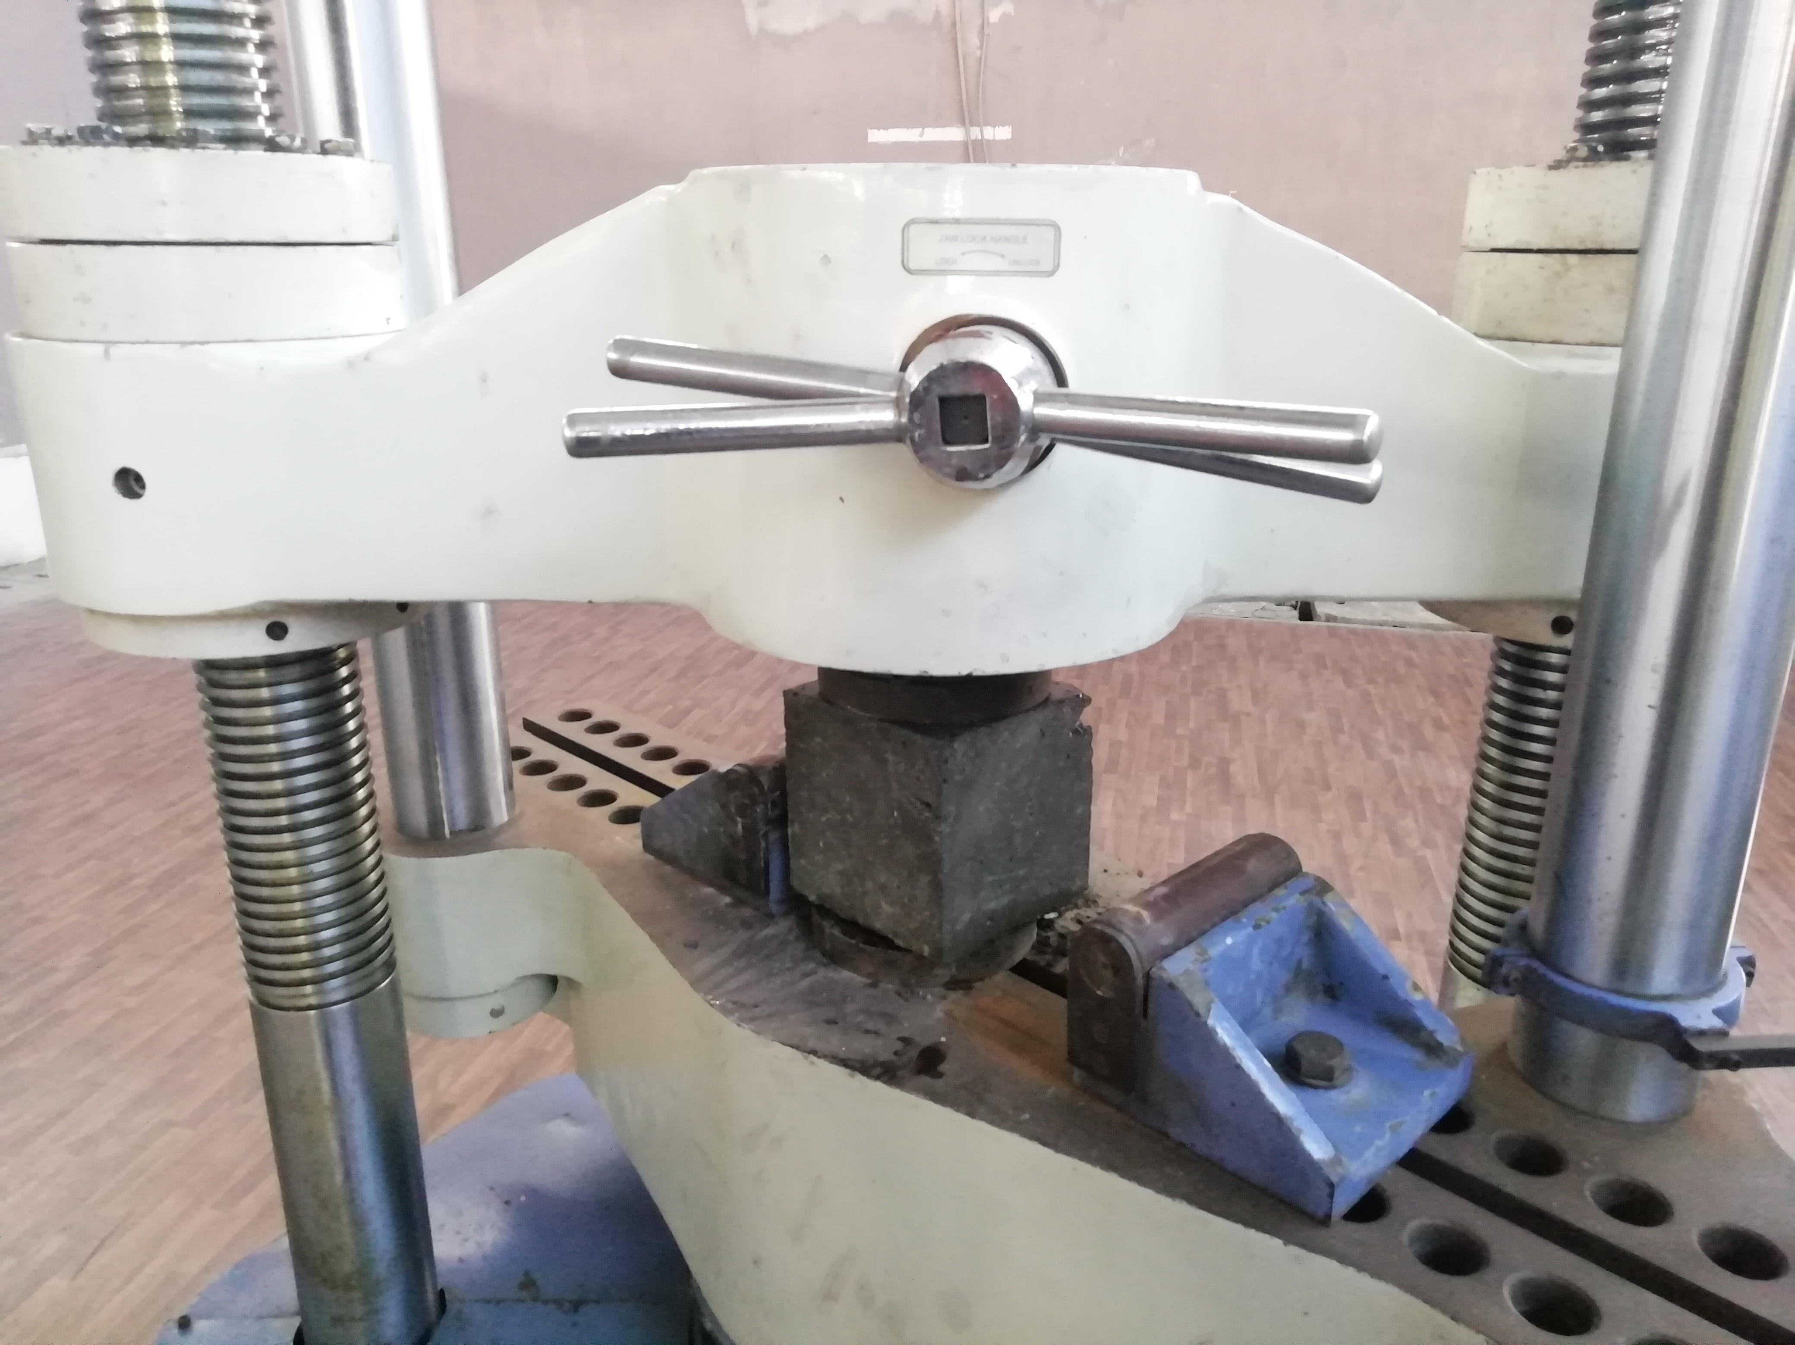
Casting and Testing of cubes
Cube were cast as per the mix ratio 1: 2.2 : 3.6.
Specimens were subjected to water curing until the time of testing.
3 cubes each were tested at the end of 7 days , 14 days and 28 days of curing.

Slide 9
Programming in MATLAB
A Program to calculate the required quantities of cement ,fine aggregate and Coarse aggregate .
The software is a real approach to find the values of required quantities based on IS 10262:2009.
The effect of specific gravity ,moisture contents ,slump values , exposure conditions etc. are incorporated .

Slide 10
LOGICAL APPROCH TO DETERMINE
THE ESTIMATED QUANTITES FOR DESIRED GRADE

Slide 11
Results
Compressive Strength of cubes
SL.NO | Load (kN) |  |  | Compressive strength (N/mm²) |  |  | Avg compressive strength (N/mm²)
 | 7 | 14 | 28 | 7 | 14 | 28 | 7 | 14 | 28
1 | 441.45 | 716.13 | 752.56 | 19.62 | 31.828 | 33.436 | 20.34 | 32.47 | 33.32
2 | 470.88 | 735.75 | 745.94 | 20.928 | 32.70 | 33.152
3 | 461.07 | 737.25 | 755.37 | 20.942 | 32.76 | 33.572

Slide 12
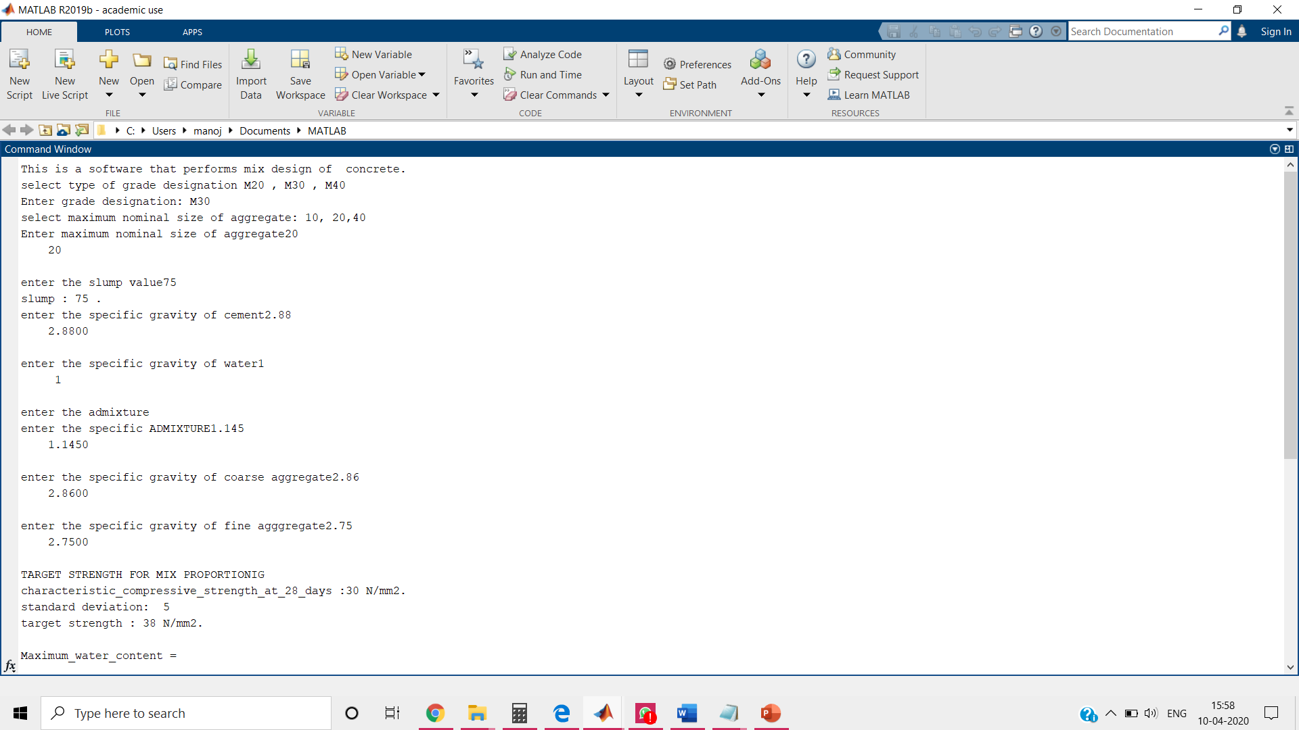
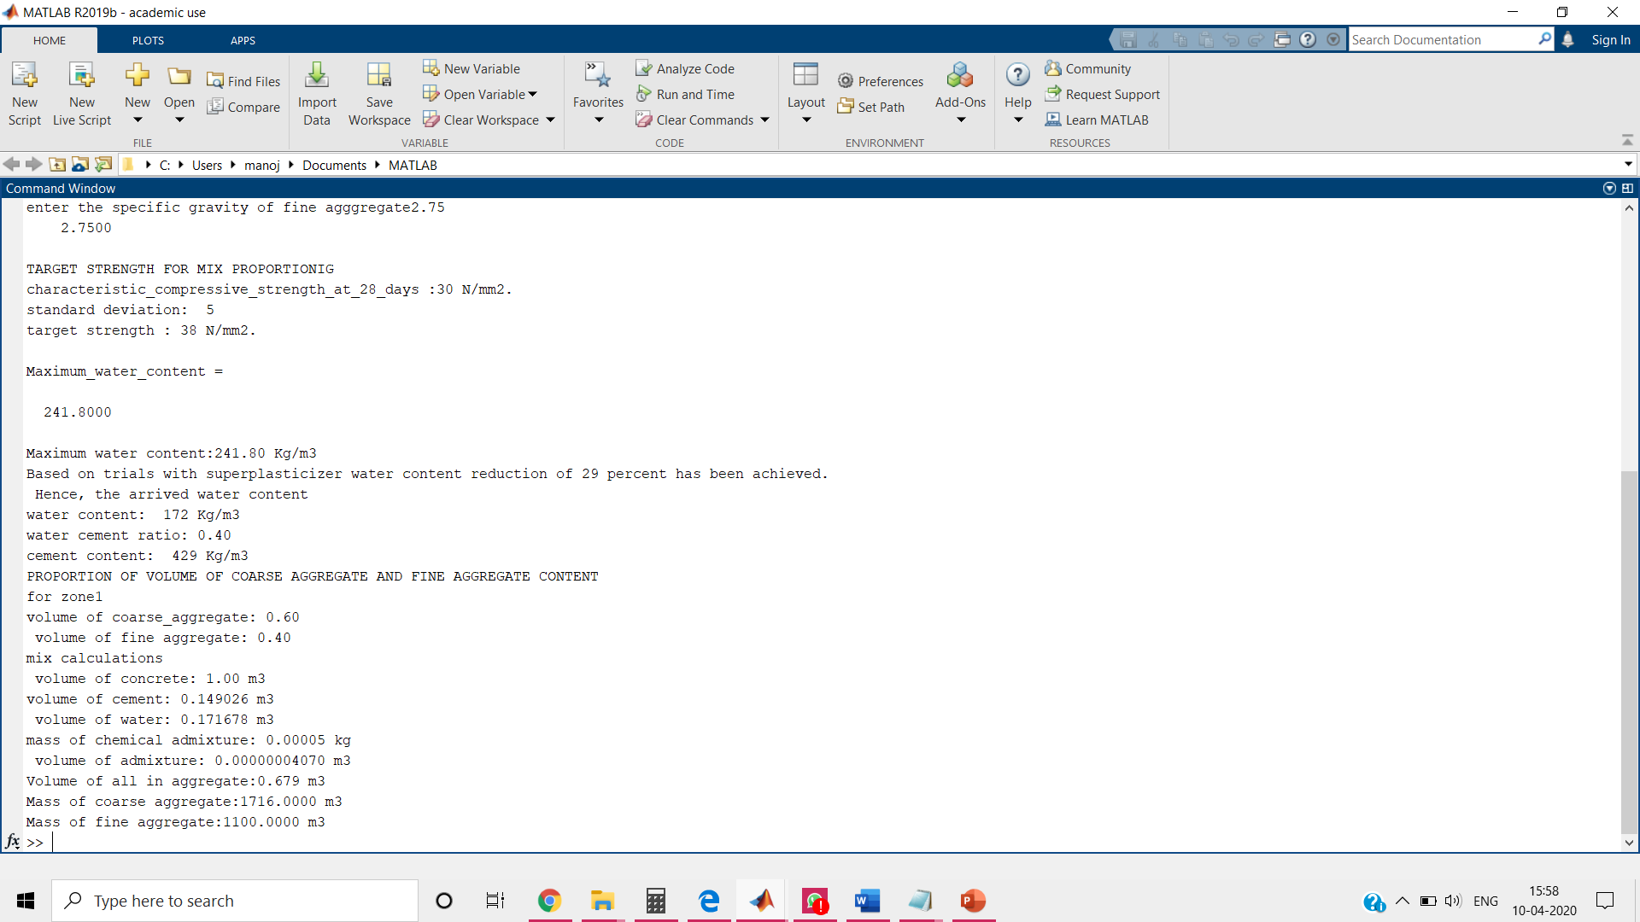
Command process in the MATLAB PROGRAM
Details of a M30 mix design command process

Slide 13
Conclusion
Mix ratio for M30 grade concrete as per IS 10262:2009 has been obtained.
Concrete cubes were and tested after 7,14 and 28 days of curing.
A MATLAB program is prepared to calculate the mix designs of M20, M30 and M40 grade of concrete.

Slide 14
REFERENCE
M S SHETTY, (2006) .CONCRETE TECHNOLOGY: THEORY AND PRACTICE . S CHAND PUBLICATIONS
IS 10262 (2009): Guidelines for concrete mix design proportioning [CED 2: Cement and Concrete]

Slide 15


Slide 16
THANK YOU

Slide 17
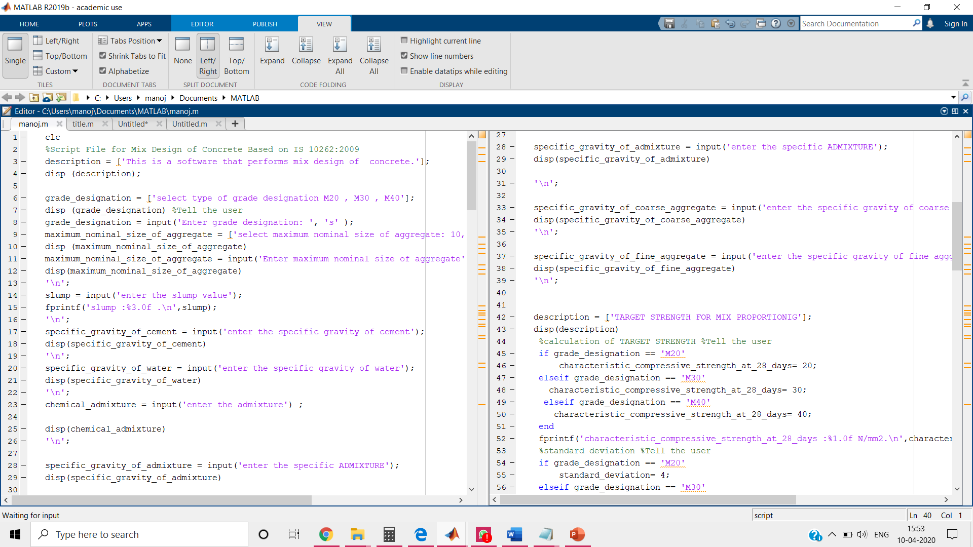
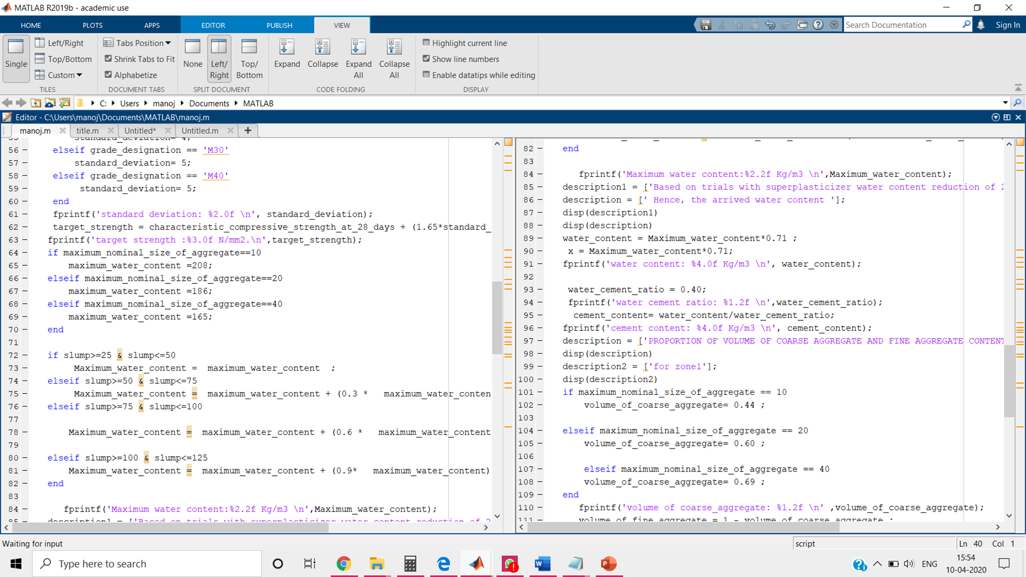
ANNEXURE
Program to calculate the mix design in MATLAB

Slide 18
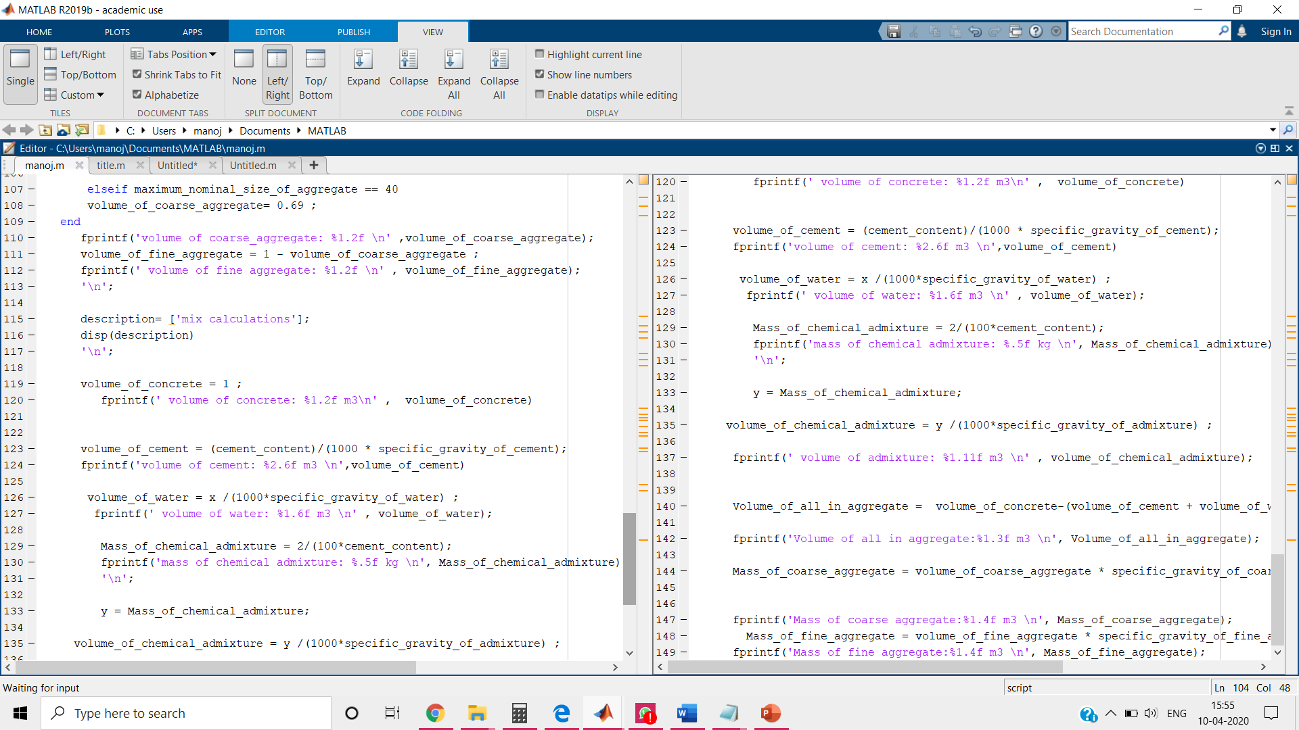
Details of MATLAB programme

